Slide 1


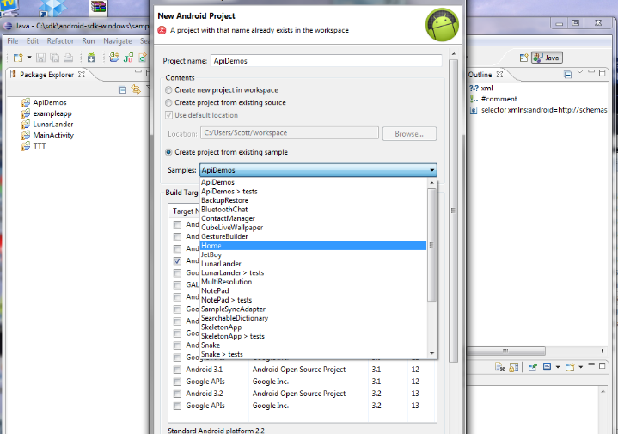
Getting Started with Android
Dimitar Ivanov
Android Mobile Applications
Telerik Software Academy
http://academy.telerik.com

Slide 2

Objectives
Android architecture and application development model
Install and configure an Android application development environment
Develop and deploy a simple Android application

Slide 3
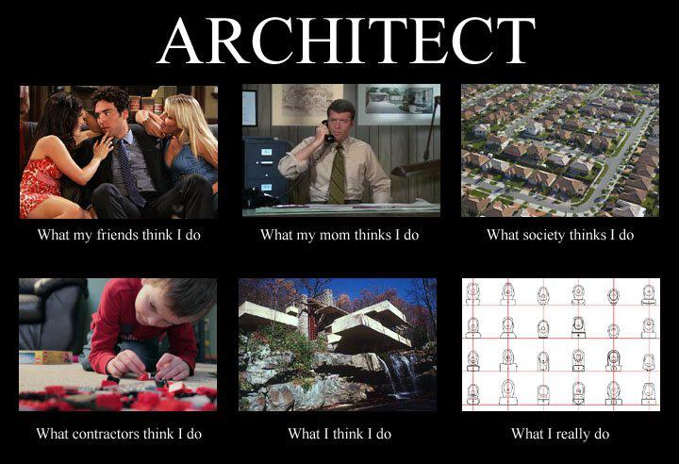
Android Architecture

Slide 4
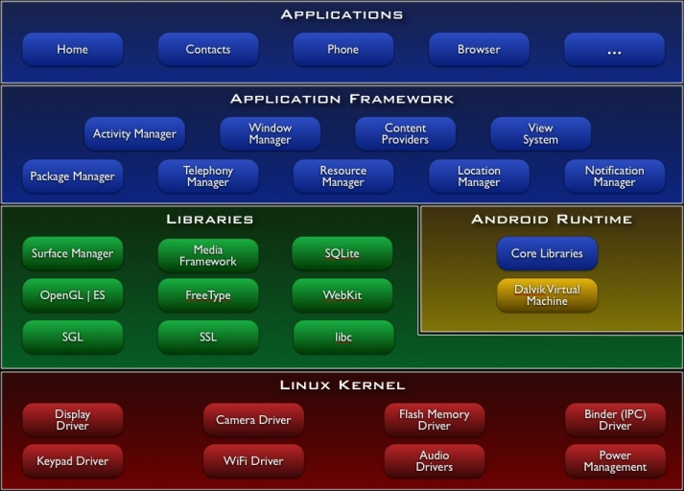
Android Architecture

Slide 5
Application Building Blocks
Activity
UI component (one screen)
IntentReceiver
Responds to notifications or status changes. Can wake up your process.
Service
Faceless task that run in the background.
ContentProviders
Enable applications to share data.

Slide 6
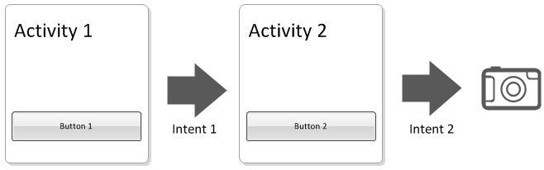
Activity

Slide 7
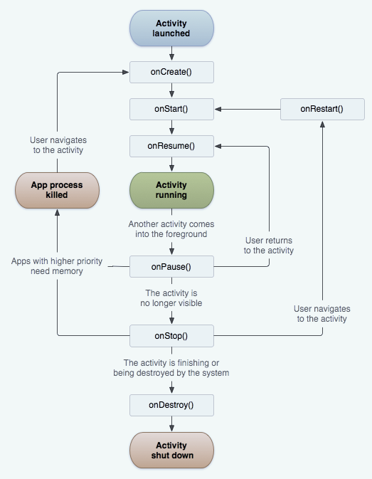
Activity Lifecycle

Slide 8
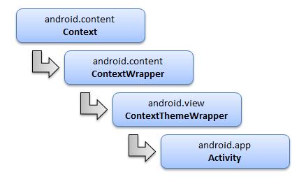
Activity Context

Slide 9
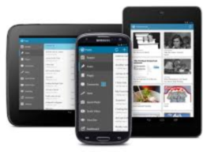
Intents
Live Demo

Slide 10
Intents
Activity to Activity communication
dataType
Object
Start with result
Intent select image from gallery
Intent share link with facebook

Slide 11

Android Resources

Slide 12
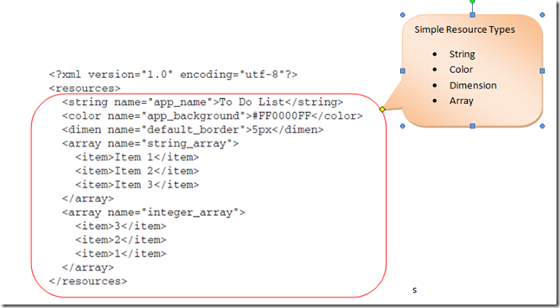
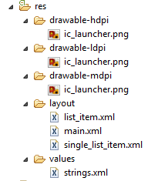
Primitive data type resources

Slide 13
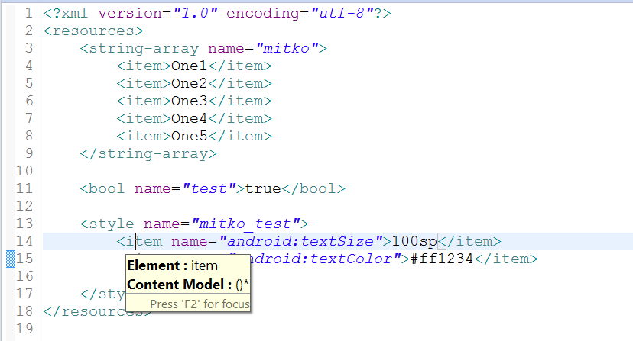
Style resources

Slide 14
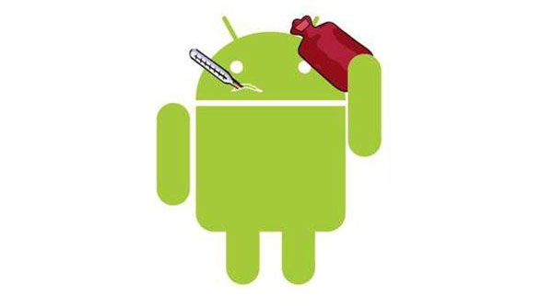
Image Resources

Slide 15

Localization

Slide 16
Getting Started with Android
http://academy.telerik.com

Slide 17
Homework
Create an android application that has two activities:
One that has a edittext and a button. The button sends the info from the edittext through an intent
And one that shows the info that is passed from the first activity
Create an android application with gridView
Use the demo about the listView implementation from the video

